Slide 1

REAL LIFE LAB (RLL) PROJECT
GROUP
6
Complaint Redressal System
Presented By :
1. K Anish (2587770)
2. Shri Raghoottam Korti (2586812)
3. Shubhangi Vijay More (2587340)
4. Sonashree (2587461)
5. Srushti Awaji (2587249)
6. Surasani Ram Reddy (2587011)
7. Vaishnavi (2587616)
8. Vignesh B (2587366)

Slide 2
CONTENTS
Title
Contents
Modules
Objectives
Software requirements
Introduction
Admin Login
Customer registration and login
Manager Registration and login
Engineer Registration and login
Testing reports
Conclusion
Thank you

Slide 3
MODULES
Name | Domain | Modules
1. K Anish | FSD User | Customer Login
2. Shri Raghoottam Korti | FSD User | Manager Login
3. Shubhangi Vijay More | FSD User | Customer Registration
4. Sonashree | FSD User | Feedback
5. Srushti Awaji | FSD User | Complaints
6. Surasani Ram Reddy | FSD User | Engineer service
7. Vaishnavi | FSD Admin/User | Admin and Manager Registration
8. Vignesh B | FSD User | Engineer login and registration

Slide 4

OBJECTIVE
Comfortable for users
User-friendly
Flexible
Fast Resolution
Transparency

Slide 5





Database: MySql Workbench Back-end: Spring Boot Suite Tool Front-End: Angular With VS-Code Testing: Postman Tool, Junit Testing
SOFTWARE REQUIREMENTS

Slide 6

Introduction
Complaint Redressal System has
Four Modules
Admin
Customer
Manager
Engineer

Slide 7
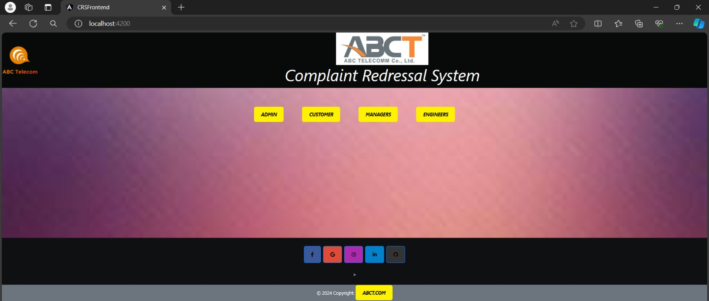
Welcome Page

Slide 8

Admin : The Admin Section is like the control hub of our Application who acts like a watchdog and controls the remaining modules. Customer : Users can create personalized accounts, conveniently and express their grievances and provide feedback. Manager : The manager has the ability to view customer complaint based on their pincode and assign tasks to engineers for resolution and can also access and review customer feedback. Engineer: An engineer is able to access assigned tasks, address grievances, and provide updates to customers regarding the status of resolution, indicating whether it has been solved, is pending, or has been escalated.

Slide 9
ADMIN COMPONENTS
Welcome page
Admin dashboard
Admin login
Validating Managers & Engineers
See Customers Feedback and Complaints

Slide 10
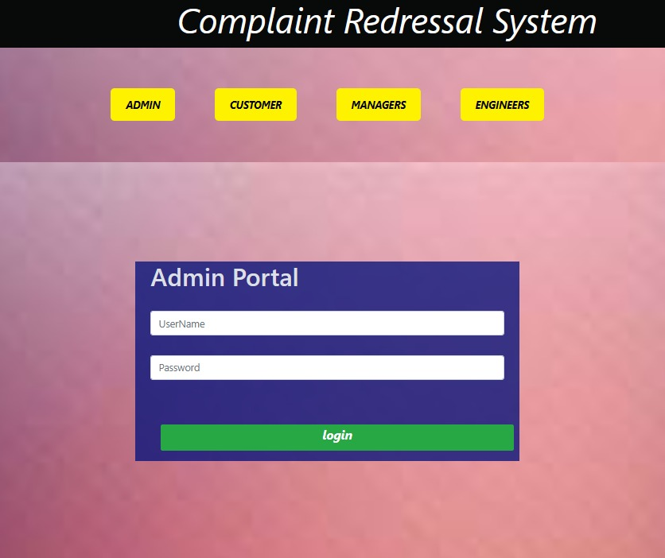
ADMIN LOGIN
Admin login is to validate admin credentials.
If credentials are matched, it will redirect to Admin dashboard
If we enter wrong credentials system will give message invalid credentials.

Slide 11
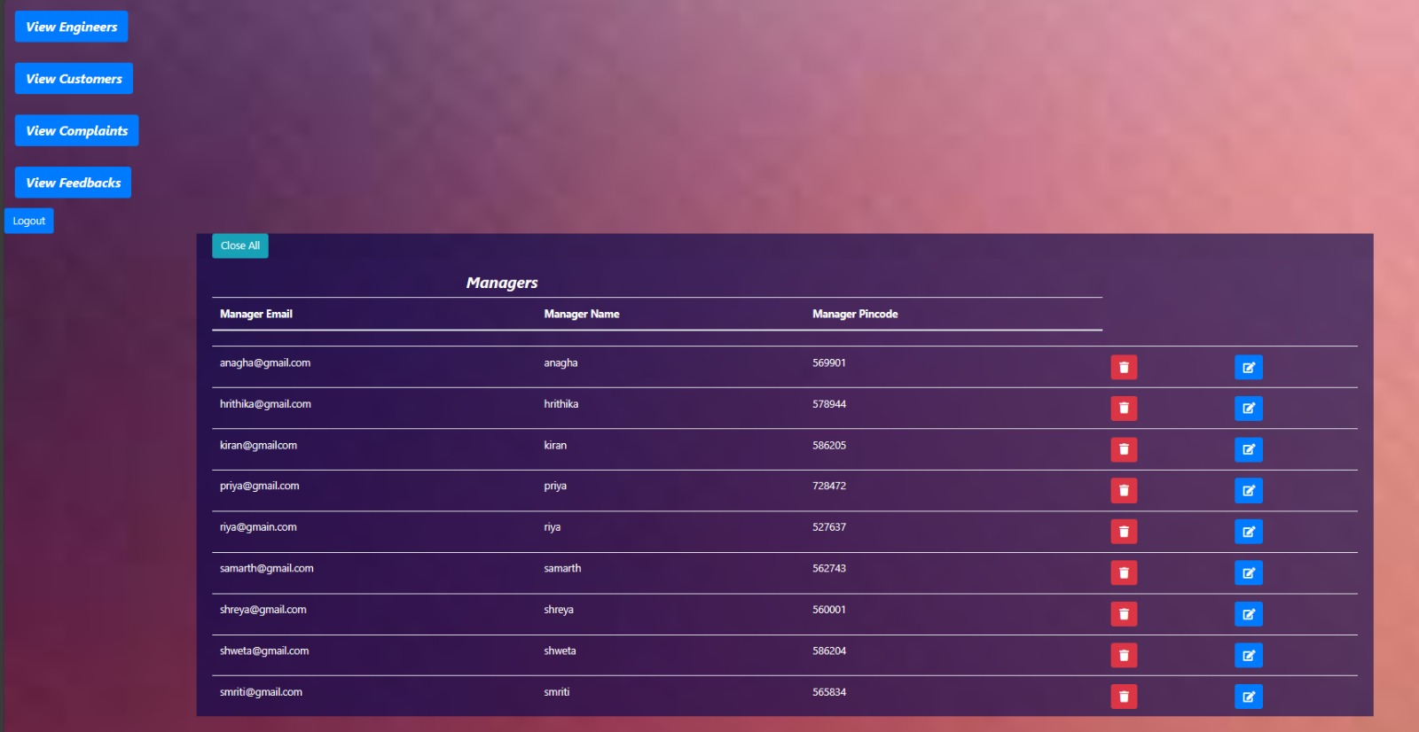
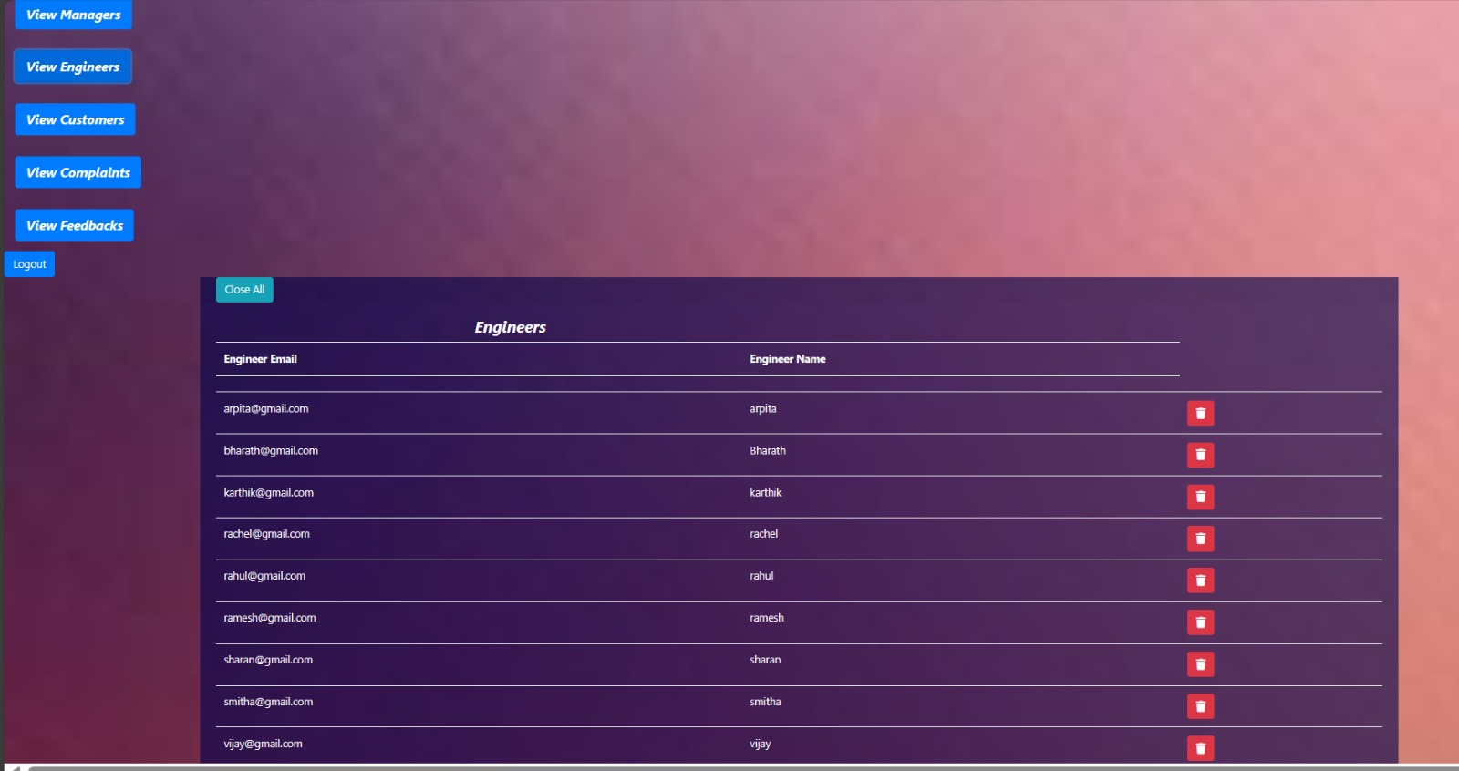
The admin controls users like Manager, Customer and Engineer. Admin enables the manager to login view the complaints and assign the tickets based on the pin code similarly Admin Enables the engineer to pick up tickets, work on them and update the status to the Customers.
Admin Dashboard

Slide 12
CUSTOMER COMPONENTS
Registration and Login
Raise or create a complaint.
View & Tracking the complaint
providing feedback

Slide 13
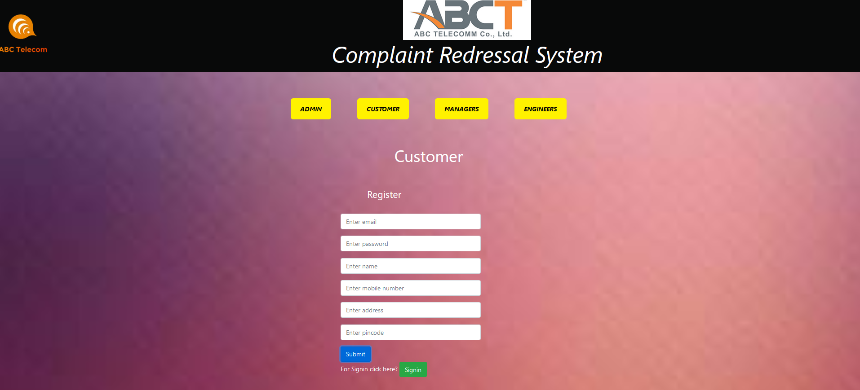
Customer Registration
The customer registers by filling out the registration form.
Customers provide minimal details including their name, address (with PIN Code), mobile number, and the type of problem.
and then submit the registration form.

Slide 14
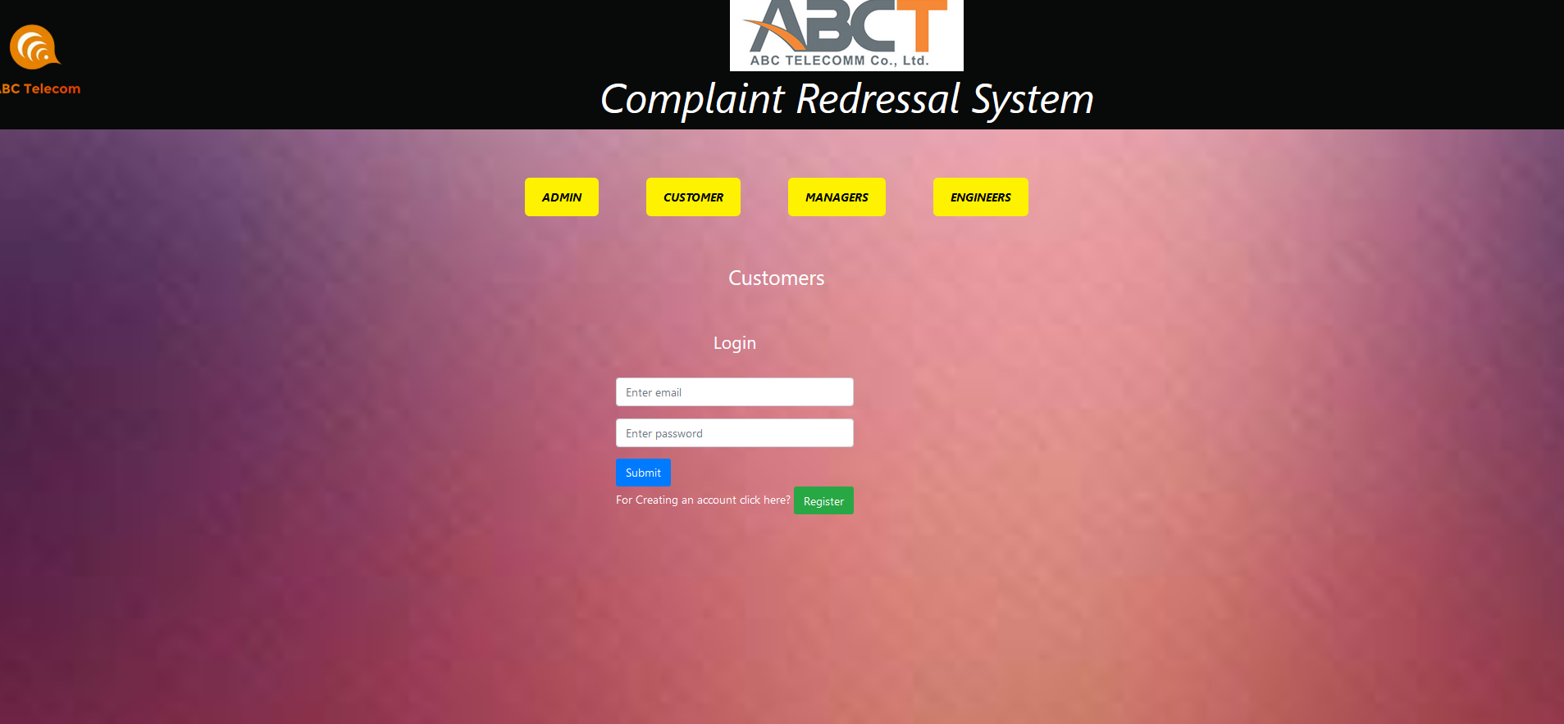
Customer Login
Customer login is to validate Customer Email ID and Password
If credentials are matched, it will redirect to Customer dashboard
If we enter wrong credentials system will give message is invalid credentials.

Slide 15
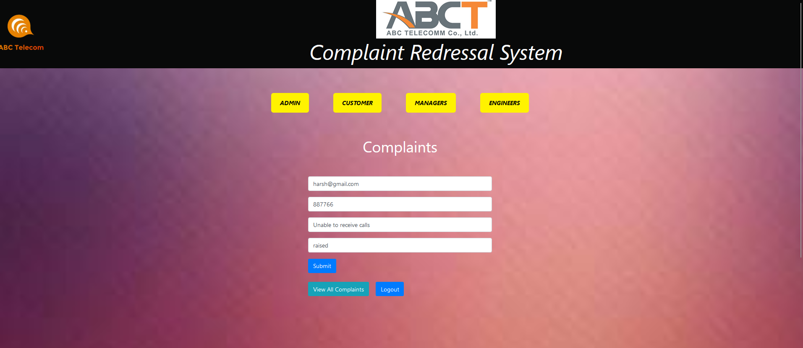
Customer - Complaints
The customer can raise a ticket for their complaint by providing their email address, PIN code, type of complaint, and current status and then registering the complaint.
Upon successful submission, the customer receives a ticket number as an acknowledgement

Slide 16
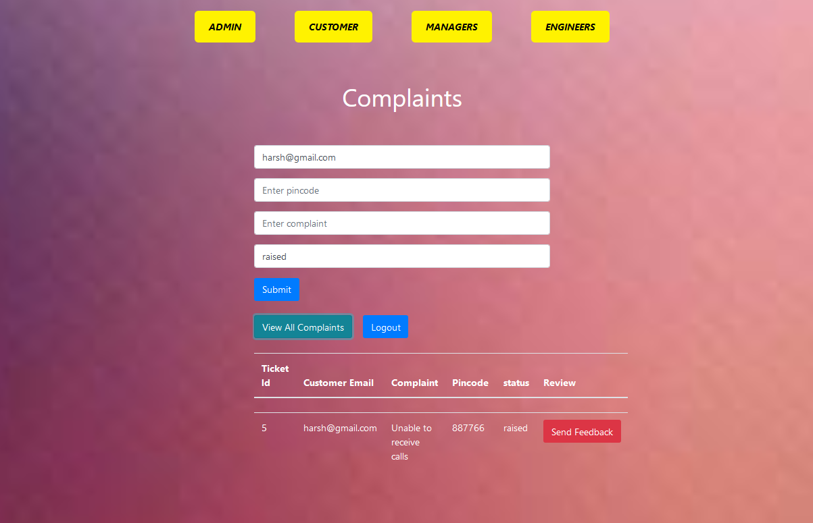
Customer – View & Tracking
Additionally, customers can view their submitted complaints and track their progress

Slide 17
MANAGER COMPONENTS
Welcome page
Manager Registration
Manager login
See Customers Complaints
Assign the tickets to Engineers
View Customers Feedback

Slide 18
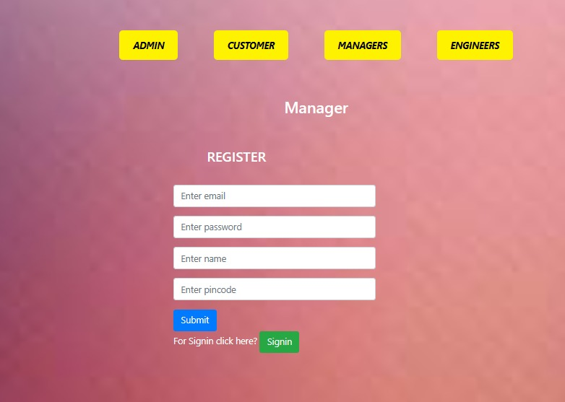
Manager Registration
After filling the necessary information like email
password ,name and pincode of the manager
he should enter the submit button.
If manager already registered then it will direct
him to signin page.

Slide 19
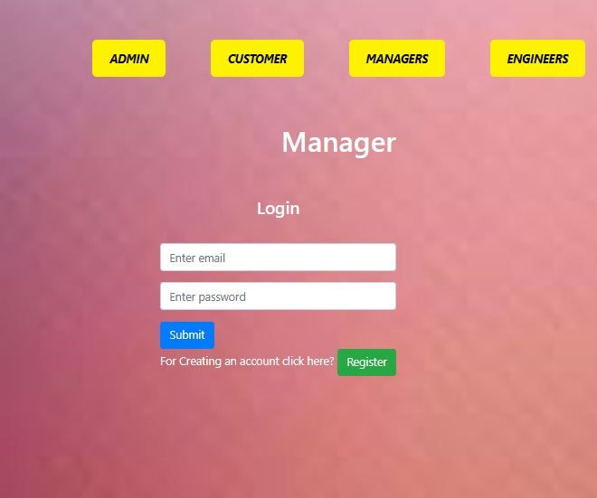
Manager Login
After completing the registration process, the
manager is required to sign in.
To sign in, the manager must enter the email
address and password used during registration.
Upon entering the email and password, the system
validates the credentials.

Slide 20
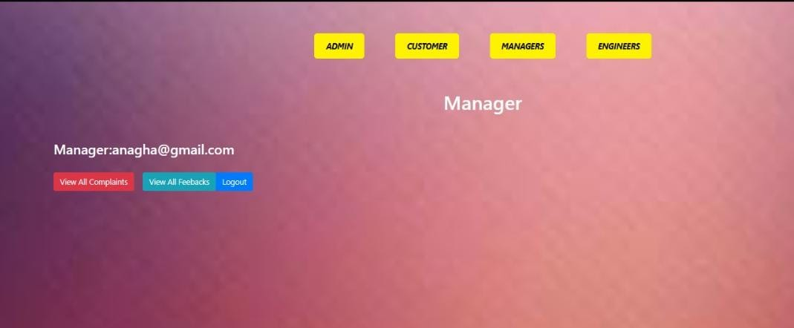
Manager Dashboard
Upon signing in, the manager gains access to the
dashboard interface.
Within the dashboard, the manager can
conveniently view customer complaints.
Additionally, the dashboard provides access to
customer feedback for review and analysis.

Slide 21
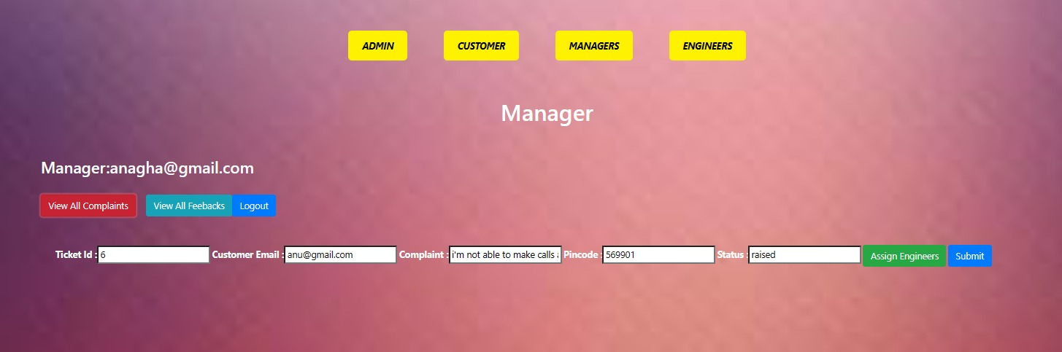
Manager Dashboard
Upon selecting "View All Complaints," the
manager gains access to a list of customer
issues.
Each entry in the list provides detailed
information, including the customer’s
email Pincode and status of the grivience.

Slide 22
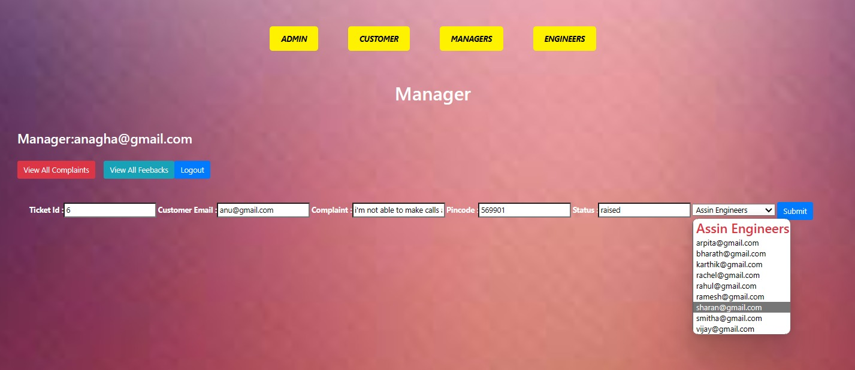
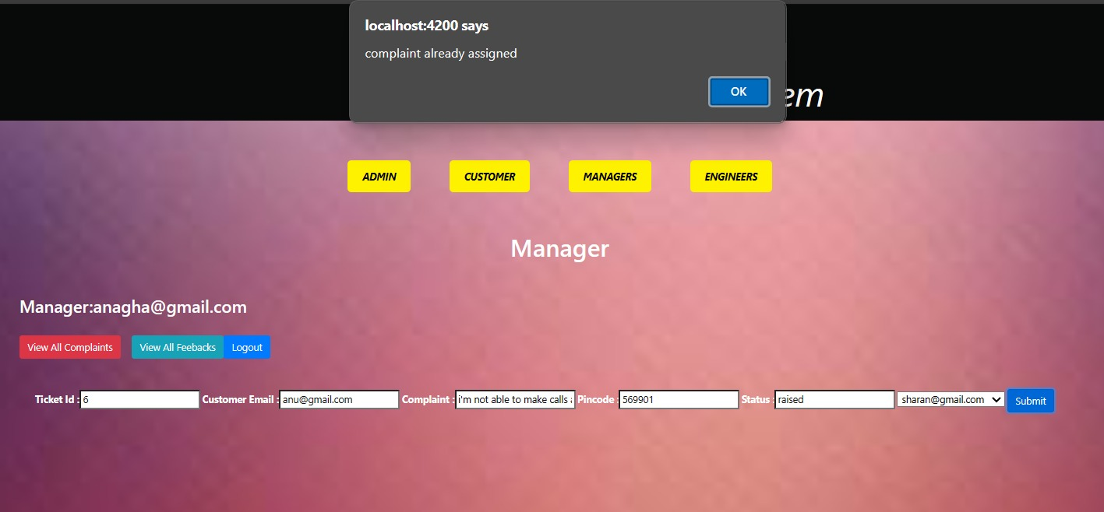
Manager dashboard
After viewing the complaint the manager will If any complaints are assigned to engineers it will assign the
tasks to the engineers to resolve the issues. tasks show as already assigned otherswise it will assign
the tasks to the engineers.

Slide 23
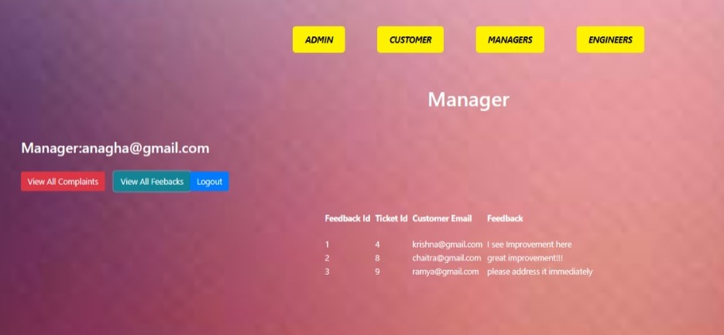
Manager Dashboard
When the manager presses the "View Feedbacks" button, the system displays all feedback submitted by customers.

Slide 24
ENGINEER COMPONENTS
Engineer Register
Engineer Login
Engineer Dashboard
View all complaints
View all feedbacks

Slide 25
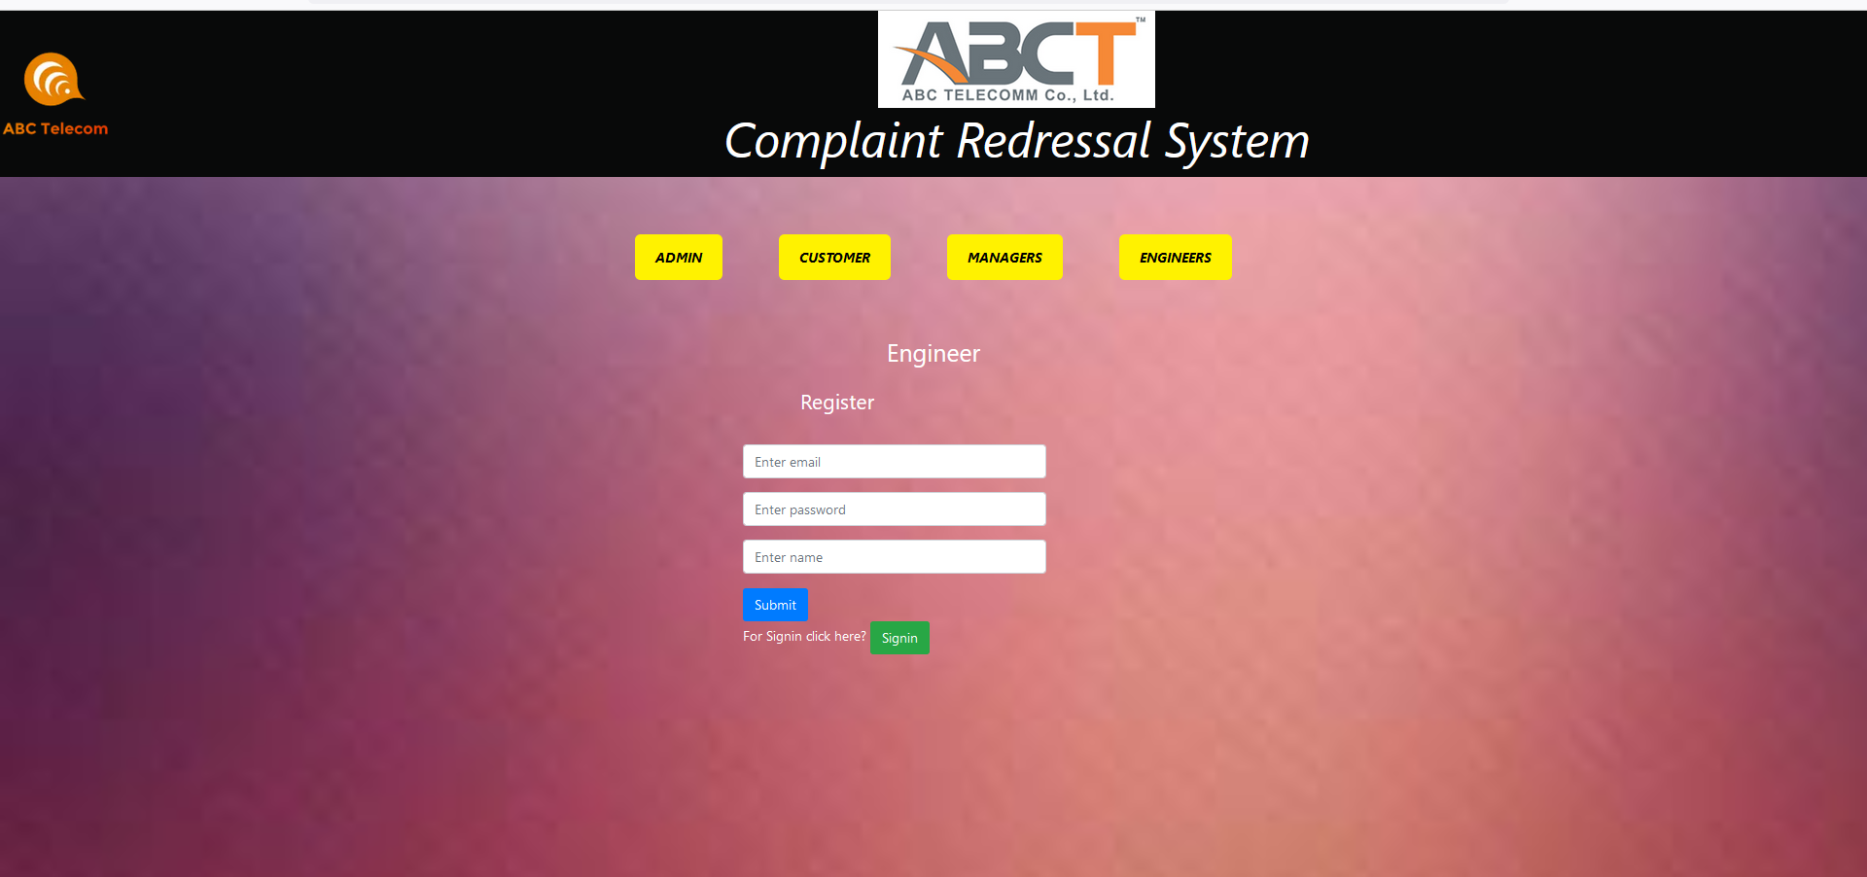
Engineer Register
Engineer can Register by providing
necessary information like Email, Password and
Name of the engineers.
After clicking on submit button an account will
be created for the engineers and the admin can
view the information regarding the engineers who
registered.

Slide 26
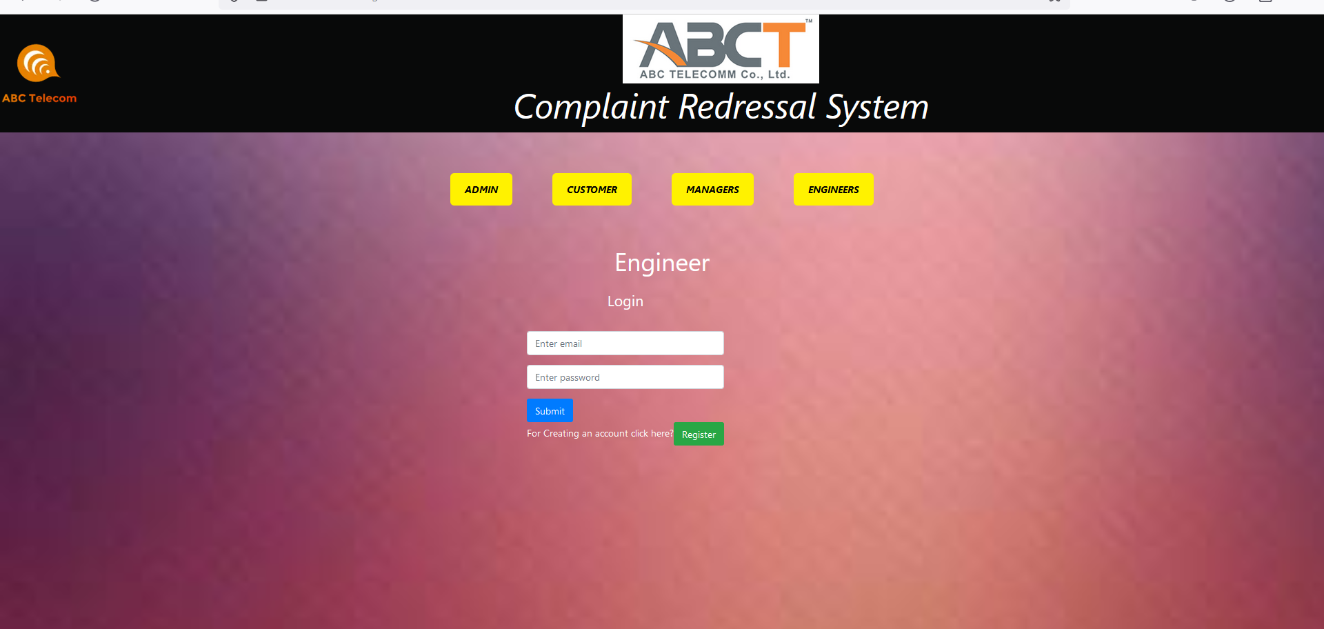
Engineer Login
*Engineer can login with their registered email and password

Slide 27
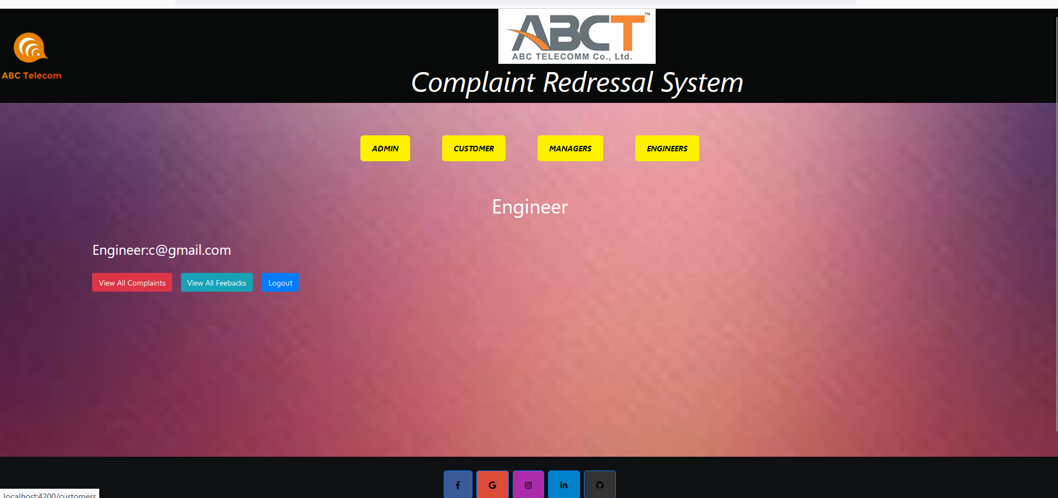
Engineer Dashboard

Slide 28
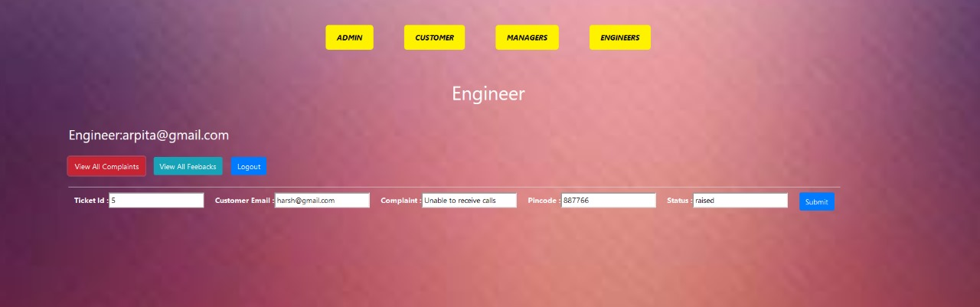
VIEW ALL COMPLAINTS
* The engineer can see all the complaints assigned to him/her along with the customer details with ticket Id attached.

Slide 29
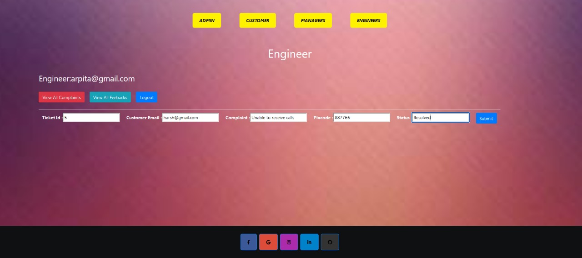
COMPLAINT STATUS UPDATE
Engineer can edit the status of the complaint raised after working and resolving it

Slide 30
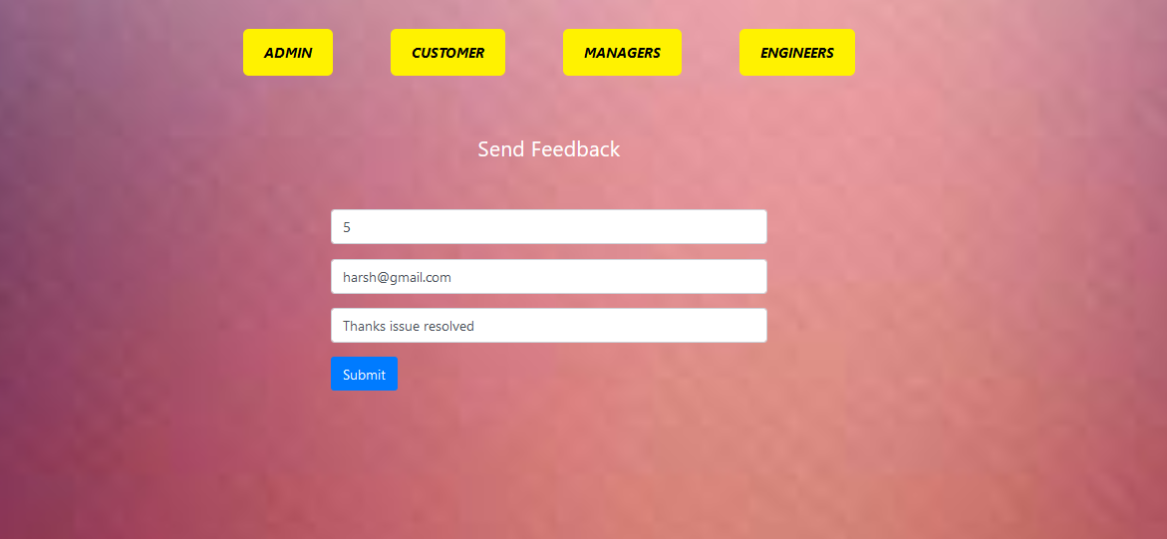
Customer - Feedback
If the complaint is resolved, customers can provide feedback by using the feedback button.
They need to enter their email address, ticket ID, and feedback, and then submit it.

Slide 31
Customer Feedback

Slide 32
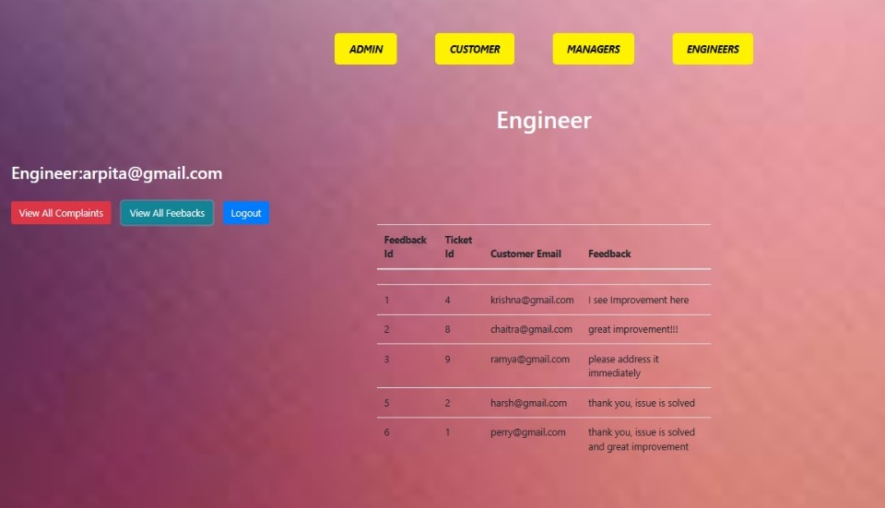
VIEW ALL FEEDBACKS
Enigneer can view all the feedbacks provided by the customers

Slide 33
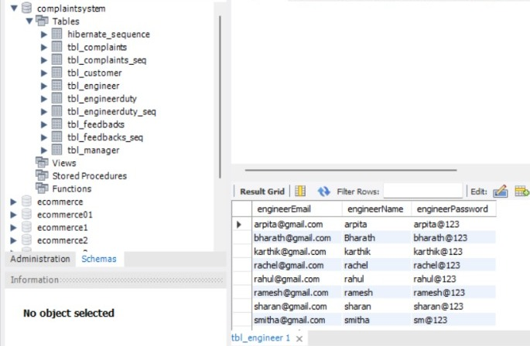
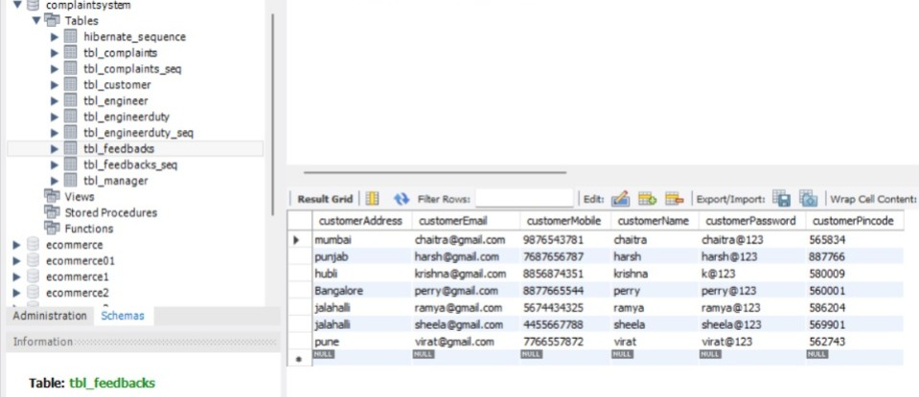
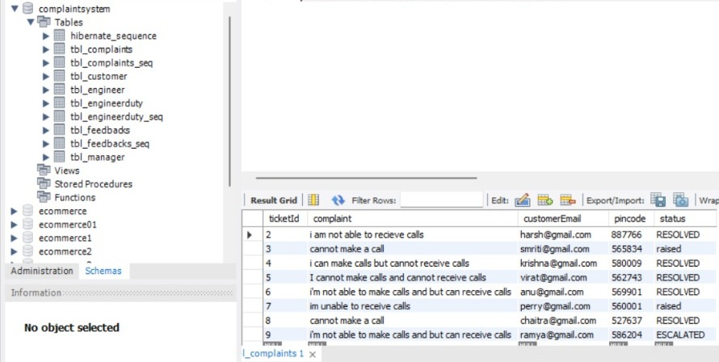
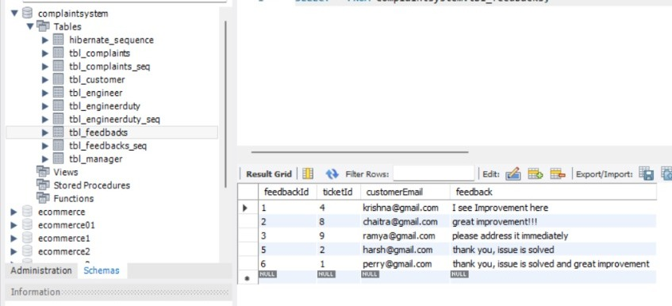
DATABASE SCHEMA
Engineer
Customer
Complaints
Feedbacks

Slide 34
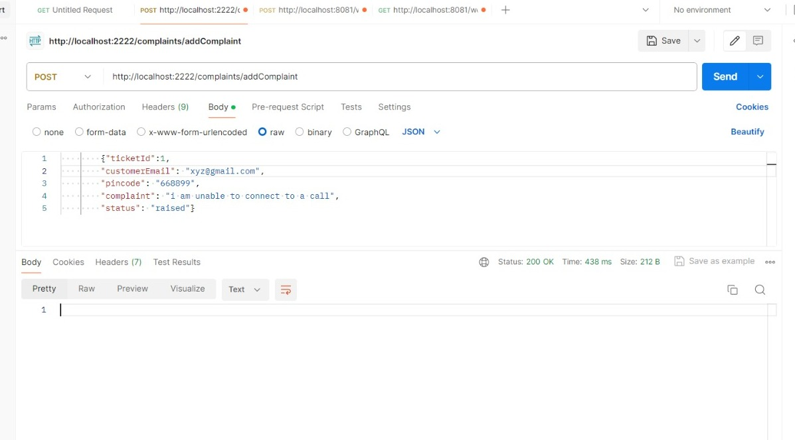
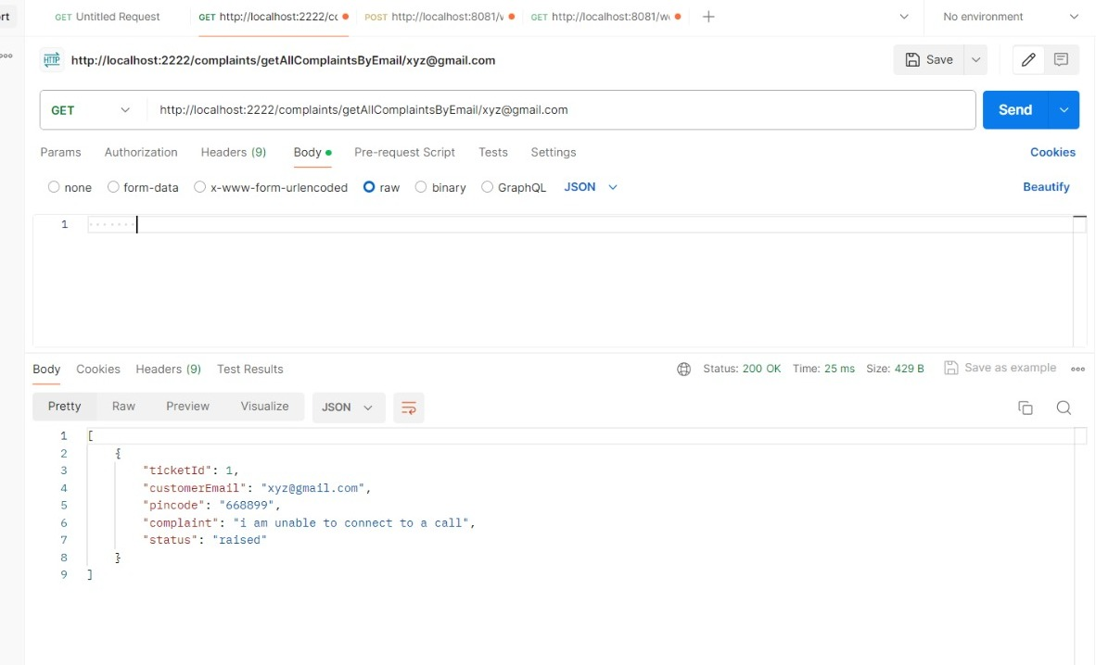
Testing

Slide 35
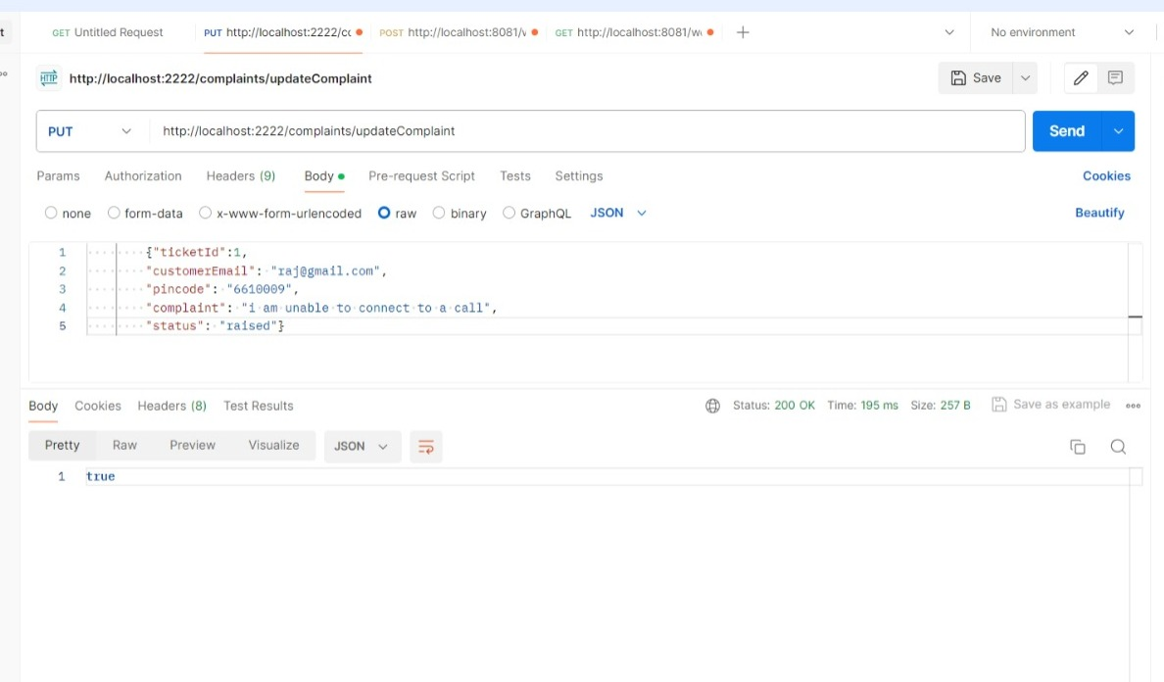
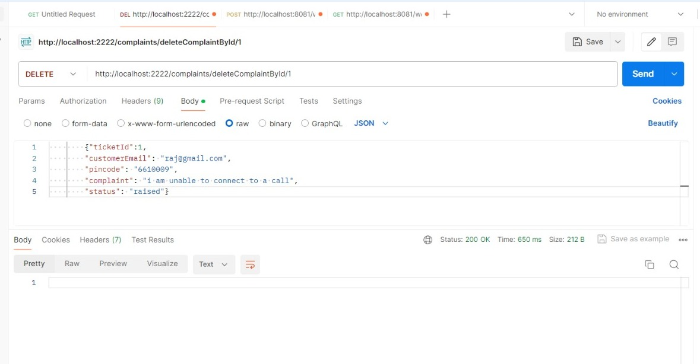
Testing

Slide 36
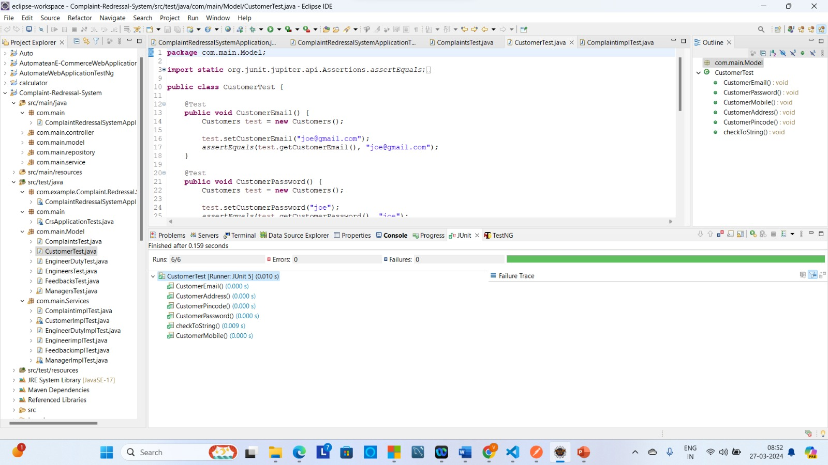
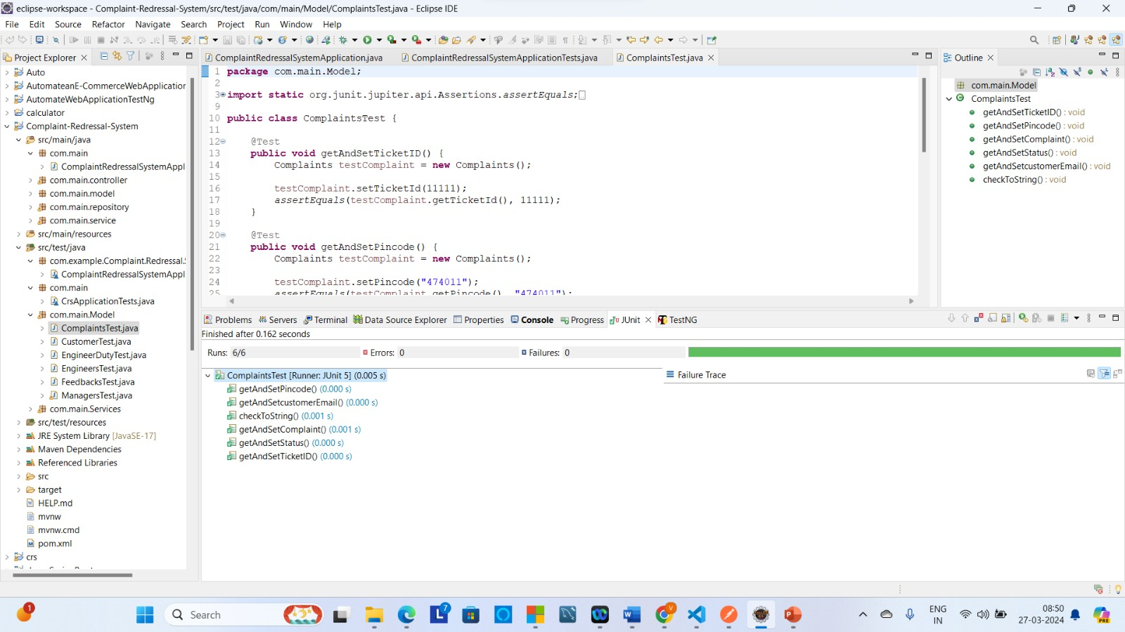
Junit Testing

Slide 37
CONCLUSION
Our Complaint Redressal System offers a user-friendly platform for consumers to report landline and broadband service issues swiftly and conveniently.
Customers can easily file complaints and track their progress, ensuring transparency and efficient resolution.
Dedicated engineers promptly address client complaints, offering timely solutions to enhance customer satisfaction.
Meanwhile, managers oversee the system's operations, managing assigned tasks and ensuring effective complaint resolution, culminating in improved consumer satisfaction within the telecom sector.

Slide 38
THANK YOU !

